Slide 1


Slide 2

Registration Open: | Mon, 4 Oct 2010
Registration Close: | Wed, 13 Oct 2010 @ 5:00 pm
Divisions: | Male, Female
Location: Teams: | Lied Rec Center 5-7 People

Slide 3
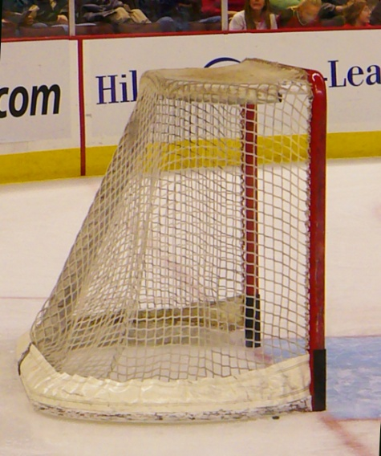
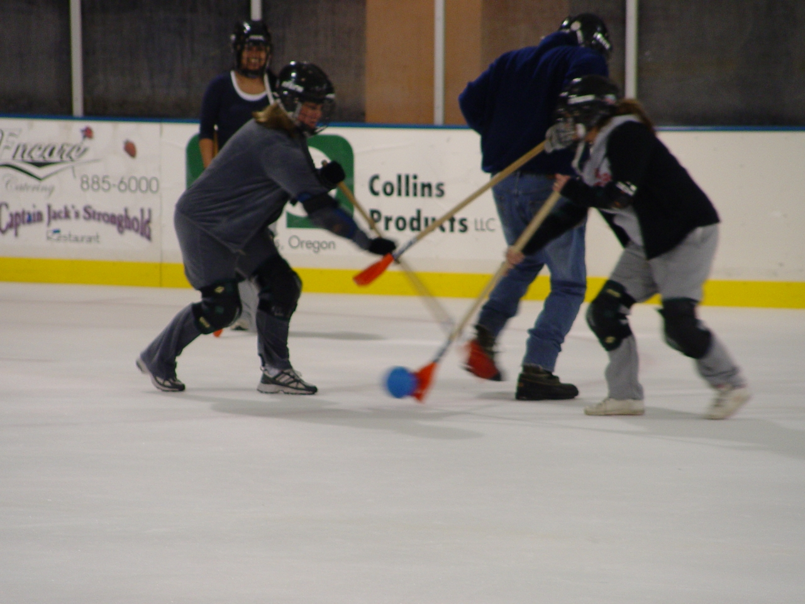
Broomball
Registration Open: | Mon, 16 May 2011
Registration Close: | Thu, 26 May 2011 @ 5:00 pm
Divisions: Cost: Played on ice in a hockey rink | Male, Female, Co-ed $45/Team

Slide 4
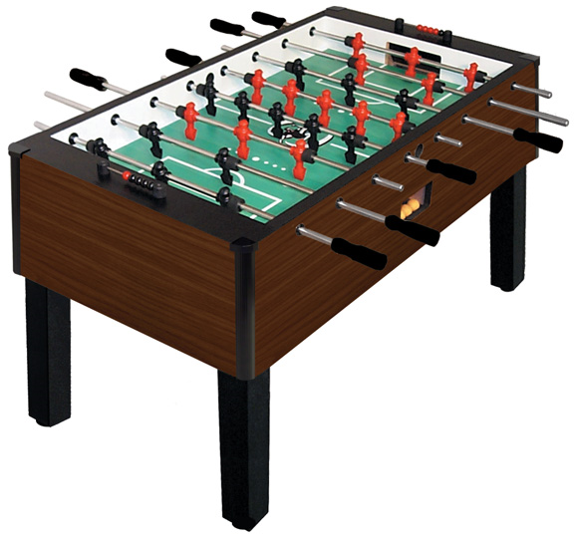
Foosball
Registration Open: | Thu, 14 Oct 2010
Registration Open: | Mon, 25 Oct 2010
Registration Close: | Wed, 3 Nov 2010 @ 5:00 pm
Divisions: | Open
Location: | Lied Recreation Center

Slide 5
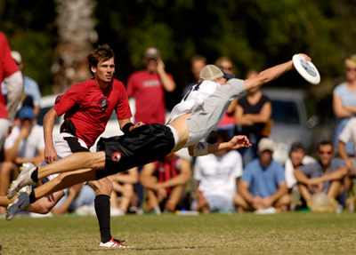
Ultimate Frisbee
Registration Open: | Mon, 28 Feb 2011
Registration Close: | Wed, 9 Mar 2011 @ 5:00 pm
Divisions: | Male, Female, Co-ed

Slide 6
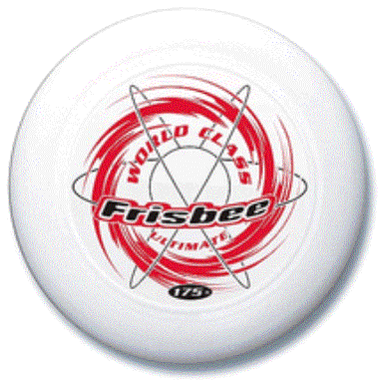
Ultimate Frisbee Rules
Each team consists of 7 players.
The game begins by one team throwing the frisbee to the other team.
You can only advance by throwing and catching (NO running while carrying the frisbee)
The goal is to catch the frisbee in the end zone.
If someone on your team drops the frisbee or fails to catch it, it becomes the other team’s frisbee (to go the other direction.)
If a team scores, they throw to the other team, yelling “Ultimate!”

Slide 7
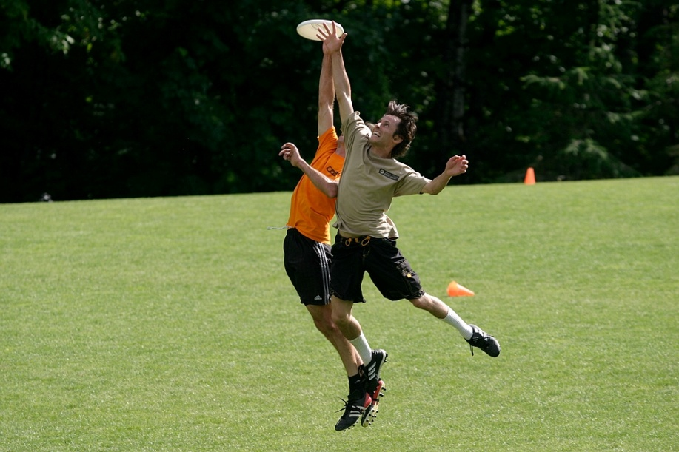
Ultimate Frisbee
Vocabulary
-Forehand VS. Backhand
-Stall (1, 2, 3, etc.)

